Slide 1


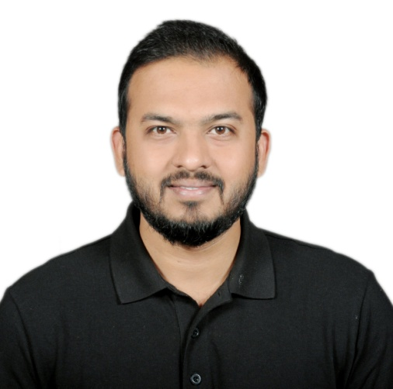
Navin Dhote
Team Lead (Cloud Apps)
Project experience
Galileo Payment System Hub Deutsche Bank, Senior Analyst
(Feb 2019 – Mar 2021)
Galileo Payment System is a Global Platform for Deutsche Bank to carry out the International i.e., Cross Border as well as Domestic Payments all over the Globe. The Payments are governed as per the SWIFT standards.
Performing Site Reliability Engineering activities such as creation and set up of infrastructure for Deploying the Application on Production.
Configuration of Continuous Integration Continuous Deployment CICD Pipeline. Successfully implemented migration from spring Boot application to Mule 4 application.
Technologies: Mule 4, Anypoint Studio, Core Java, Spring Boot, Microservices, RAML, SQL, PLSQL, Oracle11g, JIRA, Bit Bucket, Maven, Service Now, GIT, Team City, REST API. Methodologies: Agile.
State Street Liquidity Risk Management System
Oracle, Senior Software Engineer
(May 2017- Jan 2019) Implementation of product for the Liquidity Risk Management System. Providing the support after the deliveries for the reported errors. Solving the critical issues in Production Environments. Requirement Gathering, Designing along with Front End & Back End Development. Technologies: Core Java, Collections, Oracle 11G, SQL, PLSQL, JIRA, Tortoise SVN, ANT, Groovy, Gradle. Methodology: Agile
Vodafone Corporate Online Hewlett Packard, Software Engineer
(Dec 2014 – May 2017)
Worked for the telecom Giant in the UK and Germany Regions. Implemented the functionalities for the Telecomm Product for the Corporate and Individual Customers. Creation of Automation Testing Framework in Selenium and Junit for Regression Testing. Implementation of connectivity with Mule integration gateway between java app and Siebel CRM Technologies: Core Java, Mule 4, Anypoint Studio, RAML, Spring MVC, Tortoise SVN, ANT, Junit, Selenium. Methodologies: Agile.
Functional/ technical skills
Expert
Java 8
Mule 4
Rest API
Microservices
Oracle
Spring Boot
Intermediate
Anypoint Studio
Cloud
CICD Pipeline
MUnit
Beginner
AWS
Language skills
English (Native)
Hindi (Native)
Professional background
Overall 6+ years of experience in Development of Web, Integration and Migration Platforms and Applications, Enterprise and Banking applications using MuleSoft Technology and JAVA Technologies, Database Development and Microservices, Spring Boot. Experience of working in various Domains such as Telecommunication, Investment Banking, Finance, Liquidity Risk, Payments. Versatile across various roles such as Mule 4 Developer, Java Developer, Site Reliability Engineer.
Completed Diploma in Computer Engineering from University Of Mumbai in 06/2011 and Bachelors in Engineering with Information Technology from University of Mumbai 08/2014.
Trainings & Certifications
2021 - Currently pursuing for Mule 4 MCD Level 1 Certification
2014 -Oracle Certified Associate inOracle 11G – SQL and PLSQL

